Slide 1


Inventory Management System (IMS)
Matthew Garbett
January 22nd 2021

Slide 2
Introduction
I’m Matthew Garbett a trainee software specialist at QA consulting
My Approach
Used Jira Kanban Board to create sprints with user stories on each task in the specification
Focused git branching correctly using the feature method assigning the sprints as these features
Notes:
Hello My name is Matthew Garbett I’m a trainee software developer at QA academy
Today I wanted to give you an overview of how I’ve approached and completed the inventory management system project
For this I focused on the following
30-1 minutes

Slide 3
My Consultant Journey
Technologies adopted for project
Java – Used for the code of the project
Git – Used as Version Control to keep the work I have done backed up
MySQL – Used for the database that goes with the application using MySQL commands
JUNIT & Mockito – Used for testing the project
Maven – Used for adding dependencies and packaging/compiling the program.
Notes:
Moving onto my consultant journey
To complete the application I used the following
1 minute

Slide 4
My Approach to Continuous Integration(CI)
Version Control System – Git
Using git bash I used the feature branch model and merged with dev once features had been completed
Committing changes was important throughout the project
Created backups to help ease reverting changes
Notes:
Understanding how important continuous integration is to a successful project my approach was the following

Slide 5

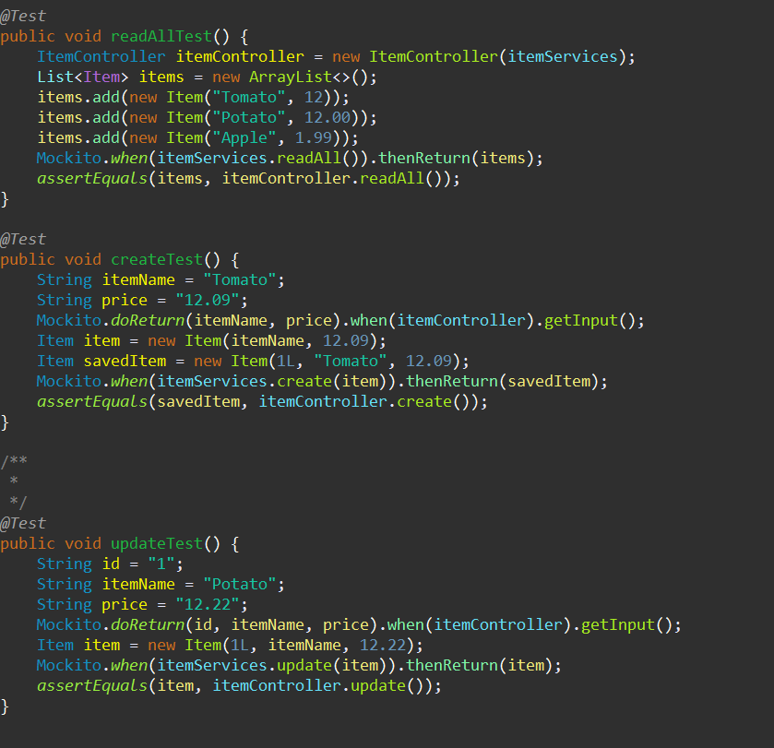
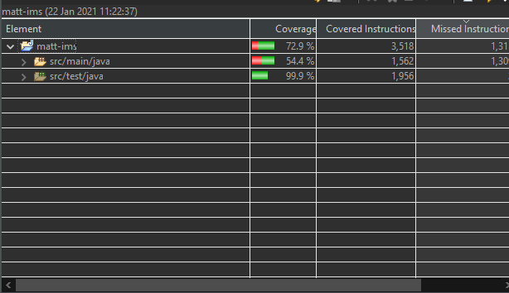
IMS Test Coverage
JUNIT Testing
Using Mockito to fake functionality on the classes
The testing allowed for a view of what methods were failing
Notes:
Looking at Test coverage I used Junit testing to test methods and Mockito to fake functionality
This allowed me to see what the test methods were expecting and therefore made it easier to adjust to test them

Slide 6

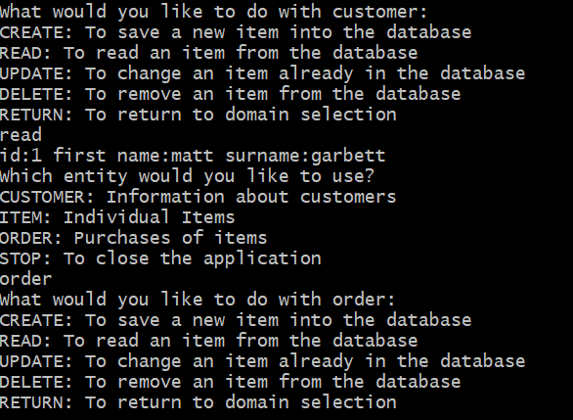
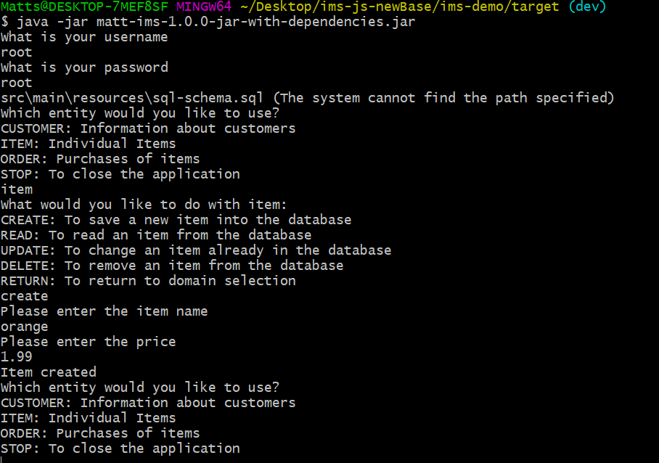
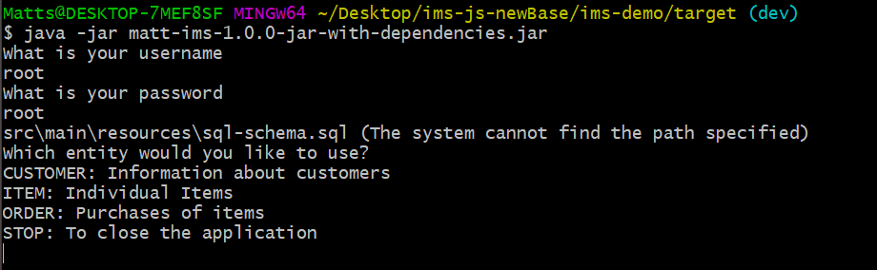
IMS Demonstration
Create item
Read item from orders
Notes:
Create item with price etc
For the demonstration I will be using a local Myql workbench to add to the database as I had issues connecting to GCP, this will be discussed in later slides

Slide 7
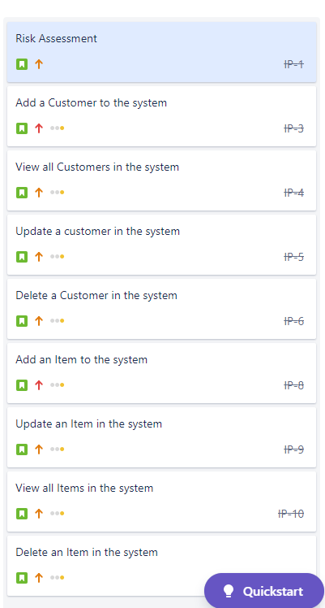
Sprint review
Completed Tasks
Completed all user stories set on Kanban Board with Risk
Assessment and Items being done the quickest
What got left behind?
Full Test Coverage (Dao Testing)
Google Cloud Platform
Notes:
Looking back at the project I was able to complete all the user stories and set off with the risk assessment

Slide 8
Sprint Retrospective
What went well?
Creating methods for each story
Git branching used for each feature splitting off from dev branch then merging back into it
What could be improved?
Start Testing earlier
Moving from local workbench to GCP
Readme file and project documents could have been continually updated

Slide 9

IMS project conclusions
Putting my learning into practice with new technologies
Future Improvements
Develop logical skills using code to
Better project management to leave more time for back-end test coverage
For future projects allocate more time to certain tasks

Slide 10
Questions? Thank you for your time

